Slide 1



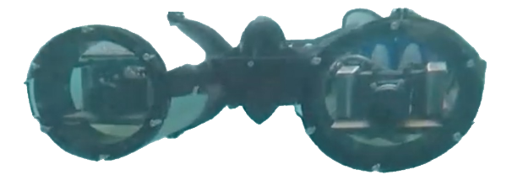
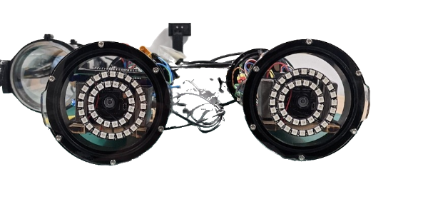
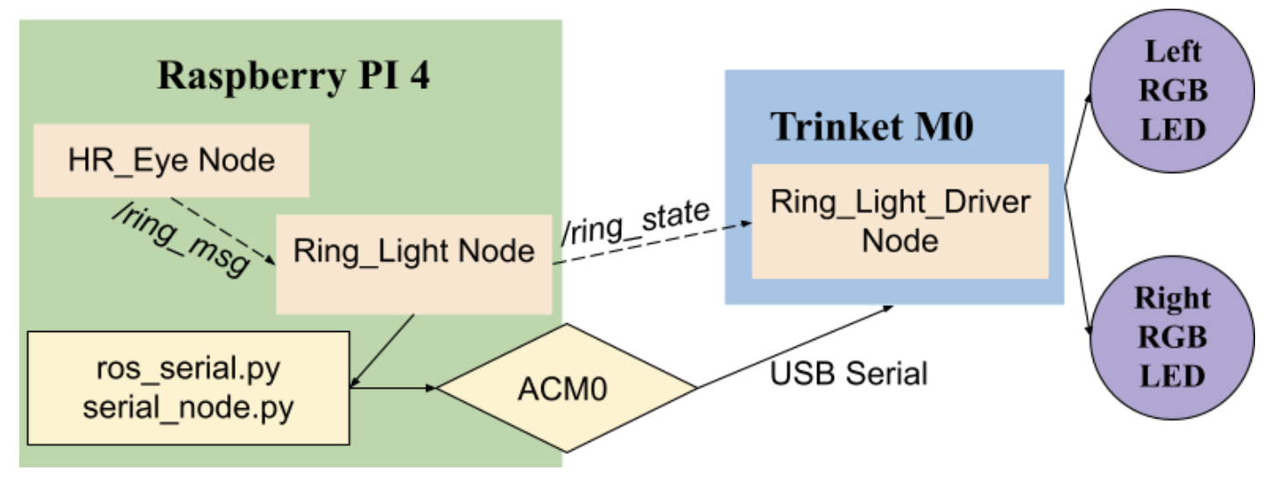
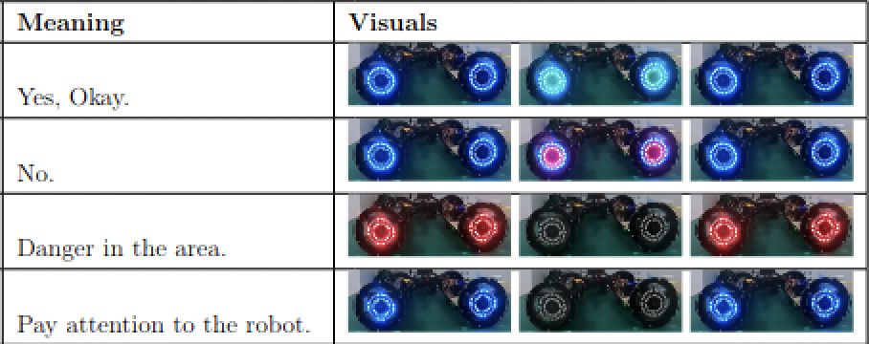
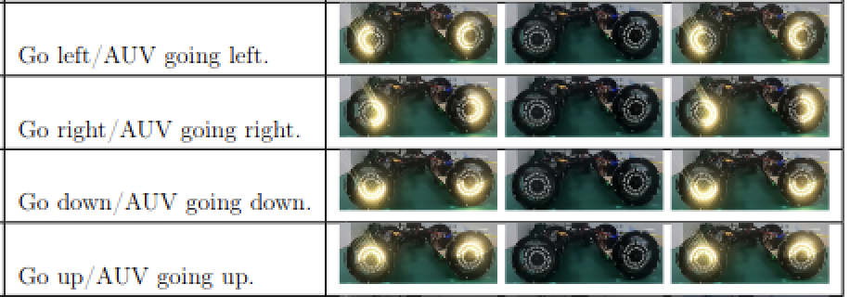
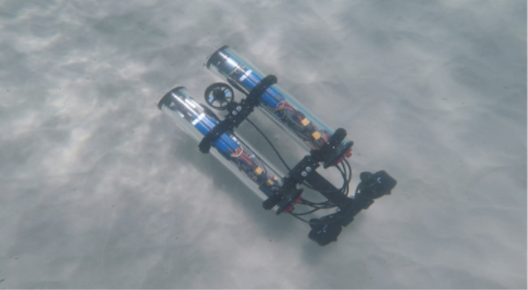


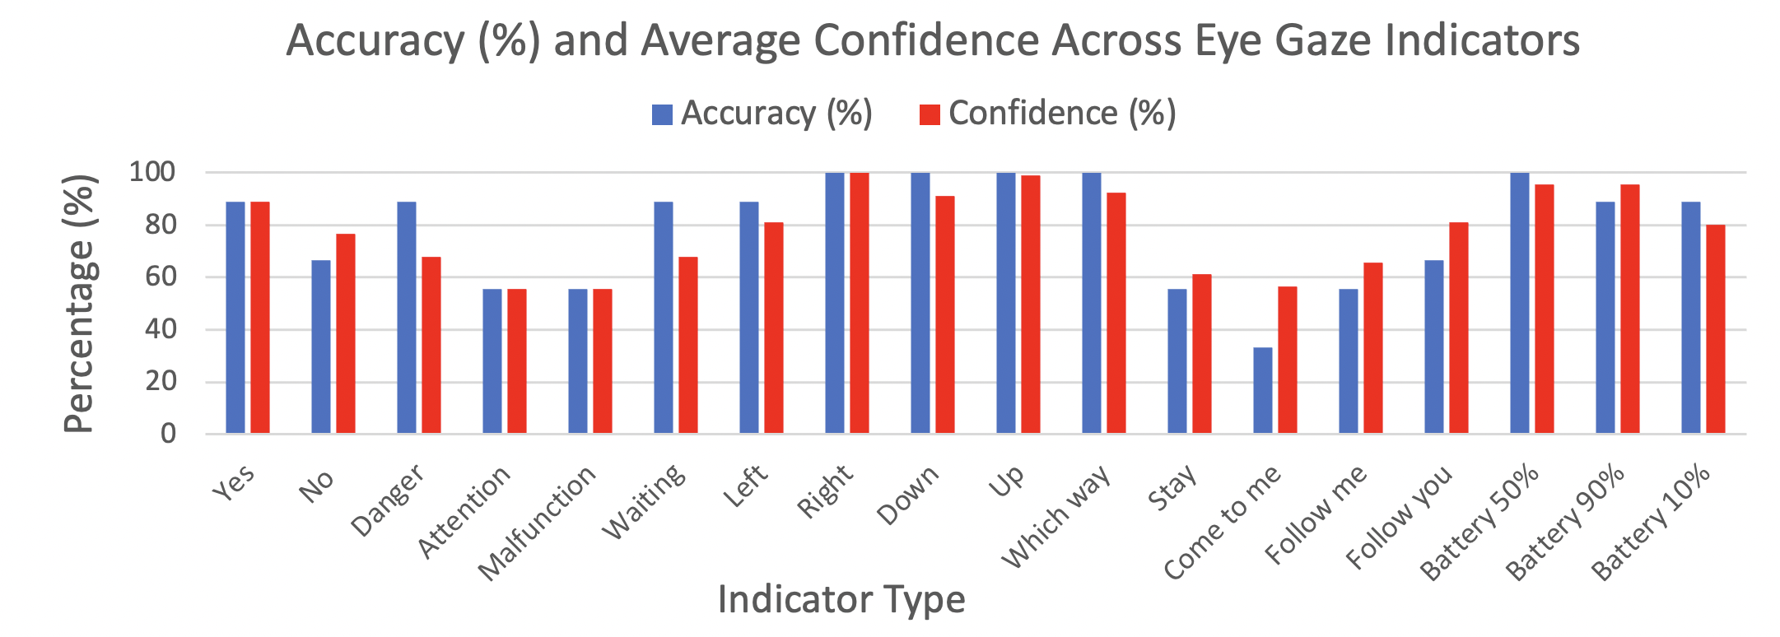
Using LED Gaze Cues to Enhance Underwater Human-Robot Interaction
Aditya Prabhu
Faculty Mentor: Junaed Sattar, Ph.D. Graduate Mentor: Michael Fulton University of Minnesota – Twin Cities
Introduction
Hardware Implementation
Front AUV without LEDs Front AUV with LEDs
Discussion
In the underwater domain, conventional methods of communication between divers and Autonomous Underwater Vehicles (AUVs) are heavily impeded.
Radio signal attenuation, water turbidity (cloudiness), and low light makes it difficult for a diver and AUV to relay information between each other.
Current solutions such as underwater tablets, slates, and tags are not intuitive and introduce additional points of failure.
Intuitive human-robot interaction (HRI) is imperative to ensuring seamless communication between AUVs and divers.
The interface for the gaze cues was developed using ROS (Robot Operating System), where nodes represent processing stages.
A string command is sent to LoCO serially on the /ring_msg data route.
A Raspberry Pi on LoCO matches the command to an animation and fills an array of pixels with RGB values.
Arrays are routed over /ring_state to a Trinket microcontroller, which fills in the actual pixels of the LEDs.
Dashed lines indicate software interfaces while solid lines indicate hardware connections.
Compared to the baseline text display communication and given participants had viewed the eye gaze animations once before, almost 3-4 days before the pool trial, the recall for 11 of the 16 indicators scored an accuracy above 80%.
These results suggest certain eye indicators convey information more intuitively than others. Particularly, directional indicators (top, right, left, bottom), battery levels, and yes/no commands.
Can expect additional exposure and training with these indicators to increase overall accuracy, while reducing the need for additional equipment such as underwater slates or tablets that can introduce logistical issues underwater.
Motivation and Objective
Evaluation of Implementation: Study Design
Contributions
Eye gazes are a natural form of relaying information between humans and are an underutilized channel of communication in AUVs.
Lights help eliminate concerns of darkness, turbidity, and signal attenuation which often impair underwater HRI.
This research aims to implement eye gazes on LoCO (a Low-Cost AUV) by installing RGB LED rings around the two camera points of the AUV.
Intend to use human participants with no prior knowledge of LoCO and HRI to evaluate intuitiveness.
Plan to compare the intuitiveness of the gaze cues with baseline printed text on LoCO’s built-in OLED display.
16 different indicators were developed to support the most common interactions underwater, a sample of which is shown on the right.
A pool trial was conducted with a sample size of 9 participants to test intuitiveness.
3 to 4 days before the trial, participants were tasked to watch each of the 16 indicator animations on a bench test of the AUV above water, and correctly match the associated meanings for each indicator.
Participants were asked to do the same for the baseline text display on the OLED of LoCO.
During the pool trial, participants were tasked to watch each of the 16 indicators played once in a random sequence underwater, recall the associated meaning, and give a confidence on their answer from a scale of 1-10.
Participants were also asked to do the same for the baseline text display
Provides an alternative and more intuitive form of communication underwater, as light animations can convey a broader range of signals and information compared to sign language, tags, underwater slates, or light codes.
Reduces the potential for logistical issues to occur as divers do not need to worry about carrying tablets, slates, or tags with them underwater.
High recall for divers with minimal training, which lowers the barrier to entry in underwater human-robot collaboration, which would currently require the knowledge of sign language, hand gestures, or using tools.
Light animations demonstrate the potential to overcome common visual barriers underwater, such as darkness, cloudiness, and far proximity between the diver and robot.
Results
Acknowledgments
A testing set of 9 participants was used across two separate pool trials, and the overall accuracy and average confidence of their responses is shown below for each eye gaze indicator.
Not pictured: the OLED text display had an accuracy of 100% and average confidence of 10 for each indicator.
This research was supported by the University of Minnesota Undergraduate Research Opportunities Program (UROP).
Special word of thanks to the Interactive Robotics and Vision Laboratory (IRV), whose guidance and expertise in HRI made this UROP possible.
For more information on the IRV Lab and the LoCO AUV, visit https://irvlab.cs.umn.edu/
Top View of LoCO AUV Underwater
Hypothesis
Implementing gaze cue animations on LoCO to convey information underwater will yield no significant difference in performance compared to written text on LoCO’s OLED display, as determined by the participant’s answer for the meaning of each gaze cue and their associated confidence in their answer.

